Slide 1
Simulation of Light Scattering and Propagation HW.9 Presentation Group6 2022/12/05
Professor: Dr. Snow H. Tseng
Presenter:
Members:
吳天予 Tammy、

Slide 2

Outline
9.1 Monte Carlo simulation examples and problems
9.2 Estimate the value of $π$ by using a Monte Carlo method
9.3 Improve the accuracy and efficiency of the Monte Carlo method

Slide 3
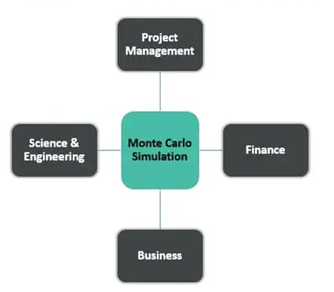
Monte Carlo Simulation Applications
It can be applied to any field for risk analysis, to solve probabilistic problems.

Slide 4
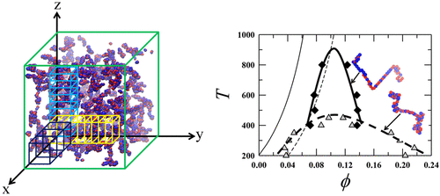
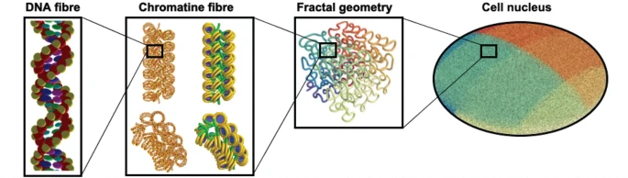
Monte Carlo Simulation Examples
Lattice Model Using Monte Carlo Simulation
Fig. 1 Lattice model of Charge-Pattern-Dependent polyampholyte phase separation
Das, S., Eisen, A., Lin, Y. H., & Chan, H. S. (2018). A lattice model of charge-pattern-dependent polyampholyte phase separation. The Journal of Physical Chemistry B, 122(21), 5418-5431.
Evaluating Damage of DNA Induced From Radiation
Fig. 2 Fully integrated Monte Carlo simulation for evaluating radiation induced DNA damage and subsequent repair using Geant4-DNA
Sakata, D., Belov, O., Bordage, M. C., Emfietzoglou, D., Guatelli, S., Inaniwa, T., ... & Incerti, S. (2020). Fully integrated Monte Carlo simulation for evaluating radiation induced DNA damage and subsequent repair using Geant4-DNA. Scientific reports, 10(1), 1-13.

Slide 5
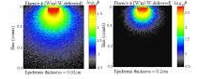
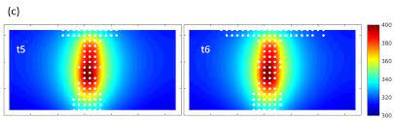
Monte Carlo Simulation Applications
Analysis of Light Absorption with Variation of Epidermis Thickness in Human Skin
Fig. 3 Analysis of light absorption with variation of epidermis thickness in human skin model using Monte Carlo simulation
Halim, A. A. A., Laili, M. H., & Rusop, M. (2019, August). Analysis of light absorption with variation of epidermis thickness in human skin model using Monte Carlo simulation. In AIP Conference Proceedings (Vol. 2151, No. 1, p. 020008). AIP Publishing LLC.
Kinetic Monte Carlo Simulation of Interface-Controlled Hafnia-Based Resistive Memory Induced From Radiation
Fig. 4 Temperature distribution at the central cross section of the filament.
Xu, X., Rajendran, B., & Anantram, M. P. (2019). Kinetic Monte Carlo simulation of interface-controlled hafnia-based resistive memory. IEEE Transactions on Electron Devices, 67(1), 118-124.

Slide 6
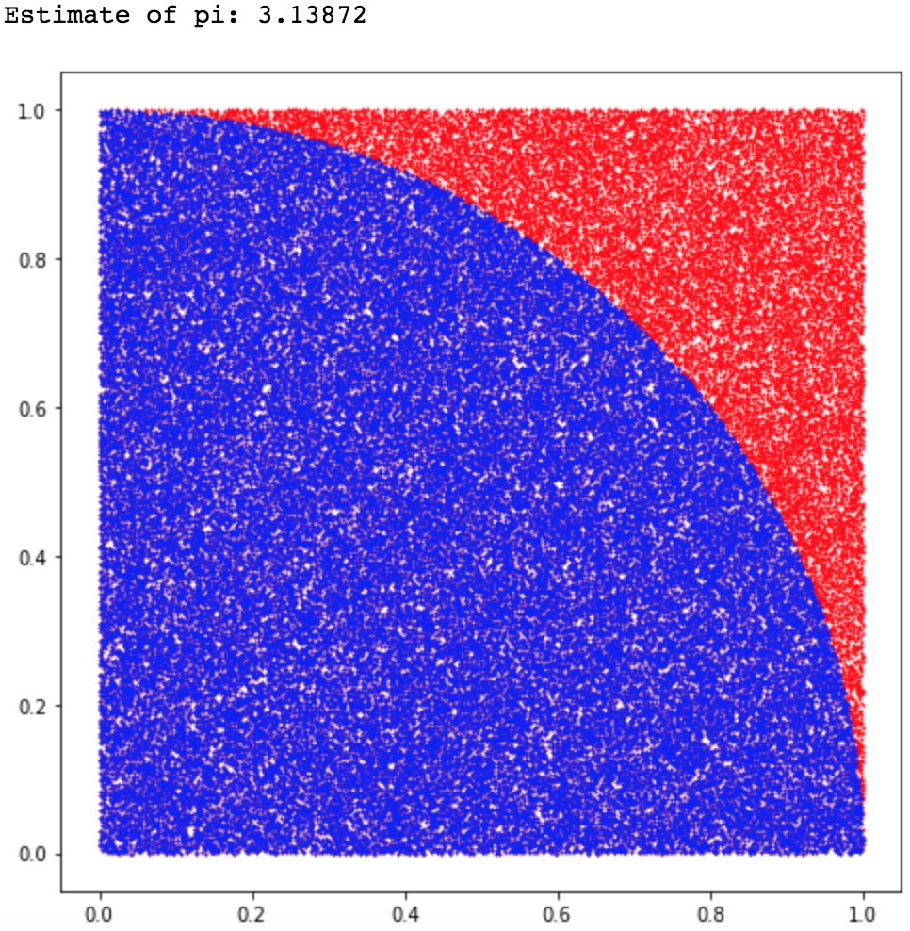
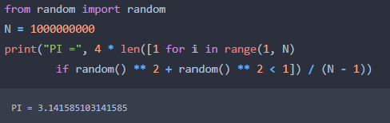

9.2 The Estimation Value of $π$by Using Monte Carlo Method
The Estimation Value of 𝝅 is 3.141585103141585
The code:
Notes:
轉動慣量所描述的是一個物體的質量與質量的分布情形。對於一個質點而言，其轉動慣量 定義為： $I=m\text{⋅}r^{2}$
Moment of inertia describes the distribution of mass and mass of an object. For a particle, its moment of inertia is defined as ： $I=m\text{⋅}r^{2}$
我們現在假設一個質點m以速率v，距離圓心r 做等速率圓周運動。我們可以清楚的知道，若以運動中的質點為參考點，其移動動能則為: $E_{k}=\frac{1}{2}mv^{2}$
We now assume that a particle m is in constant circular motion with velocity v from the center r. We can clearly know that if the mass point in motion is used as the reference point, the kinetic energy of its movement is: $E_{k}=\frac{1}{2}mv^{2}$
然而，我們現在將參考點移至圓心。參考點是固定的，因此不應有移動動能。那運動中的質點的動能跑去哪了?
However, we will now move the reference point to the center of the circle. The reference point is fixed, so there should be no moving kinetic energy. Where does the kinetic energy of the particle in motion go?
改寫成${ E}_{k}=\frac{1}{2}mv^{2}=\frac{1}{2}(mr^{2}){\left(\frac{v}{r}\right)}^{2}$ 其中，$mr^{2}$是轉動慣量$I$ ; $\frac{v}{r}是$角速率$ω$

Slide 7
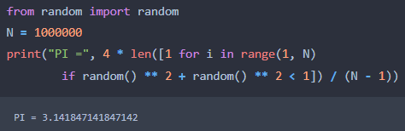
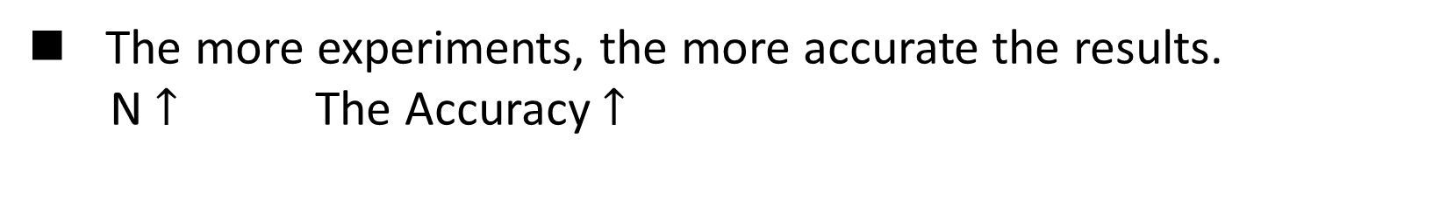

How to improve the accuracy of the Monte Carlo method?
The more experiments, the more accurate the results.
N $↑$ The Accuracy $↑$
N = 1000000
The Estimation Value of 𝝅 is 3.141847141847142
N = 1000000000
The Estimation Value of 𝝅 is 3.141585103141585
The Accuracy $↑$
Notes:
平行軸定理能夠很簡易地，從剛體對於一支通過質心的直軸（質心軸）的轉動慣量，計算出剛體對平行於質心軸的另外一支直軸的轉動慣量。
The parallel axis theorem makes it easy to calculate, from the moment of inertia of a rigid body about one straight axis passing through the center of mass (the axis of mass) , that the rigid body has about another straight axis parallel to the axis of mass moment of inertia
首先，讓我們假設一個不規則，質量為m的物體，其質心位置在原點，且接下來的轉軸皆平行於z軸。根據定義，我們可以得知該不規則物體過原點轉動軸的轉動慣量為
First, let us assume an irregularity with mass of m, whose center of mass is at the origin, and the following axes of rotation are all parallel to Z axis. According to the definition, we can know that the moment of inertia of the irregular object passing through the origin is ( 第1個公式)
接著，我們的目標是要求得該物體過P點，座標為(a, b)轉動軸的轉動慣量。根據定義，轉動慣量仍可寫為
Next ,our goal is to get moment of inertia of the axis of rotation whose coordinates are(a, b) which the object pass trough P point. By definition, the moment of inertia can still be written as ( 第2個公式)
然而，這裡的r代表的是各個質量元素dm相對於P點轉軸的距離，因此要寫為
However, r represents the distance from each quality element dm relative to P point of the rotation, so it is written as ( 第3個公式)
>>>下兩頁投影片
展開公式得第4 、5行公式

Slide 8
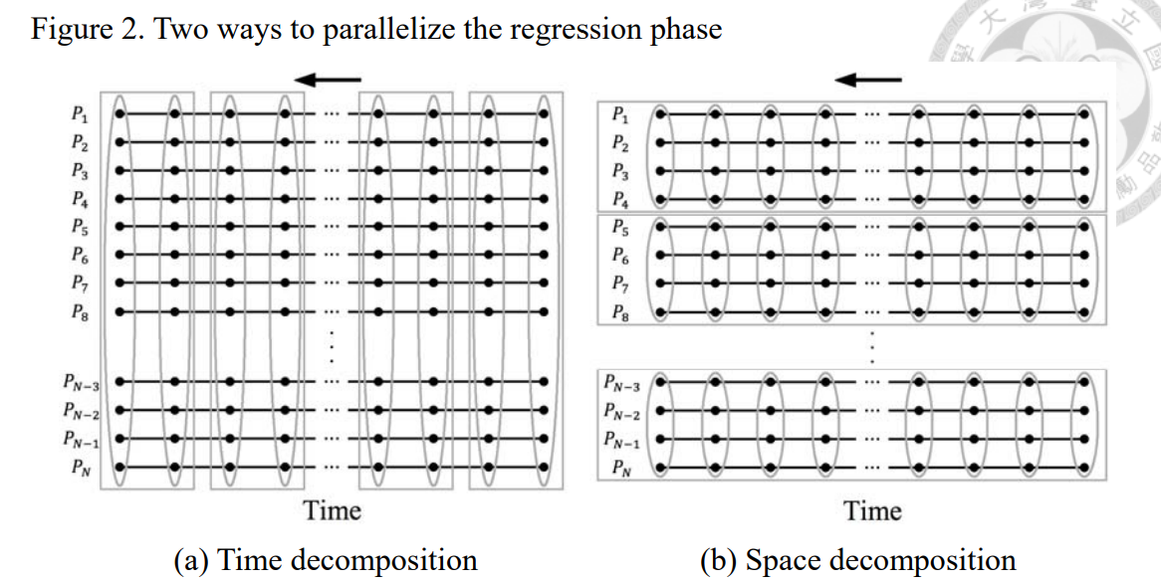
How to improve the efficiency of the Monte Carlo method?
For example
Accelerating the Least-Squares Monte Carlo Method with Parallel Computing
Parallel Computing Efficiency $↑$ ( 55 times faster )
Fig. 5 This thesis accelerates the popular least-squares Monte Carlo method (LSM) in finance with parallel computing. Several processes are created to solve LSM.
Chen, C. W., Huang, K. L., & Lyuu, Y. D. (2015). Accelerating the least-square Monte Carlo method with parallel computing. The Journal of Supercomputing, 71(9), 3593-3608.
Notes:
平行運算 55倍加速
https://www.airitilibrary.com/Publication/alDetailedMesh1?DocID=U0001-2406201412151200&PublishTypeID=P003

Slide 9

Q&A

Slide 10
Monte Carlo Simulation
Limitations of Monte Carlo Simulation
It is a time consuming and complicated method.
It is not an easy method for quantitative risk analysis. You need software to run this method.
There should be enough samples or inputs to ensure realistic results.
Results can be effected from the implementors bias.
Correct analysis and results depend on the quality of the estimates.
The is tool provides a number of results based on the probabilities. It does not give the actual result.

Slide 11
Monte Carlo Simulation Example
Benefits of Monte Carlo Simulation
It enables to make realistic forecasts or manage activities that involve uncertainty.
It enables to get accurate results by exploring thousands of combinations with “what-if” analysis.
In this simulation, it’s possible to model interdependent relationships between input variables.
It helps to improve the quality of decisions.
It helps to make forecasts for budget, schedule, and other important project work.
This tool provides graphical and visual data. This helps to improve communication among project team and stakeholders.
This tool shows the inputs which have the biggest effect on the result.

